Slide 1
2020 Annual IFTA Business Meeting
August 12 - 13 Tempe, AZ

Slide 3
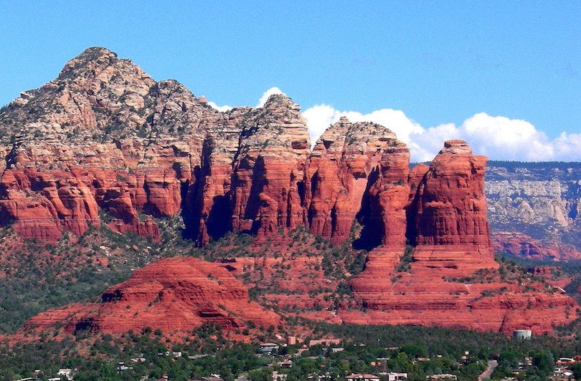

Slide 4
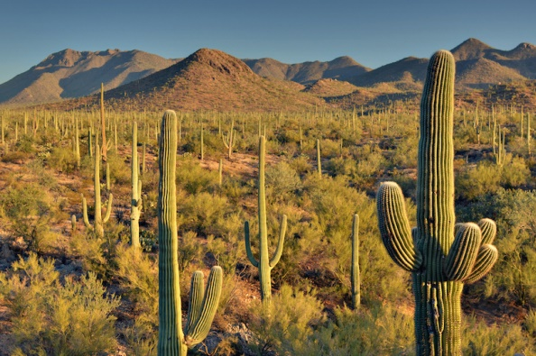
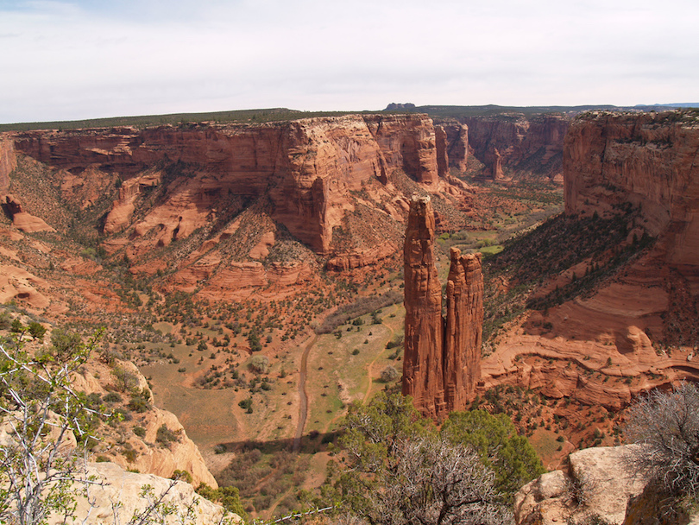
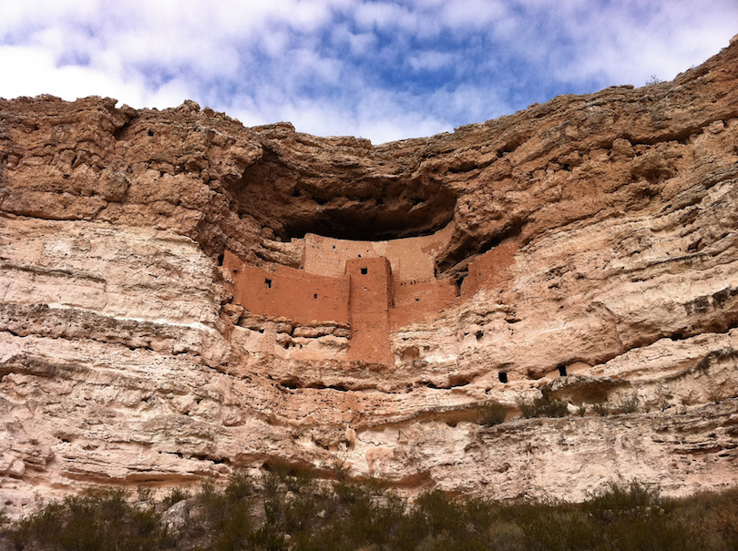

Slide 5
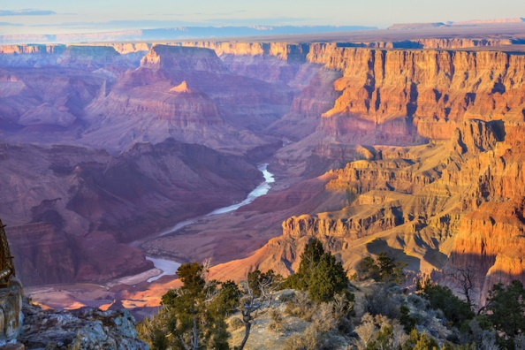

Slide 6
Mission Palms Hotel and Conference Center
60 East Fifth Street
Tempe, AZ 85281
480.894.1400

Slide 7
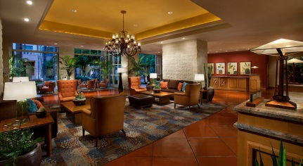
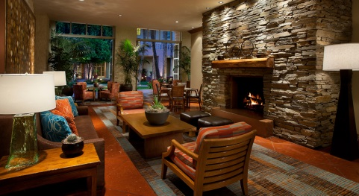
Lobby
Welcoming
Relaxing

Slide 8
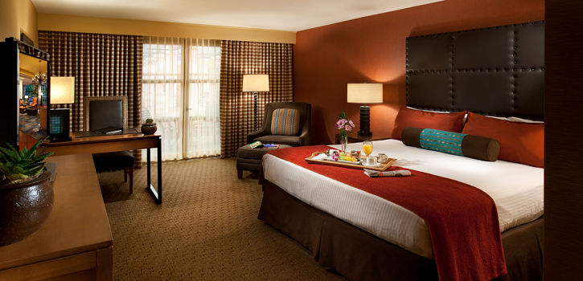
Deluxe Guestroom

Slide 9
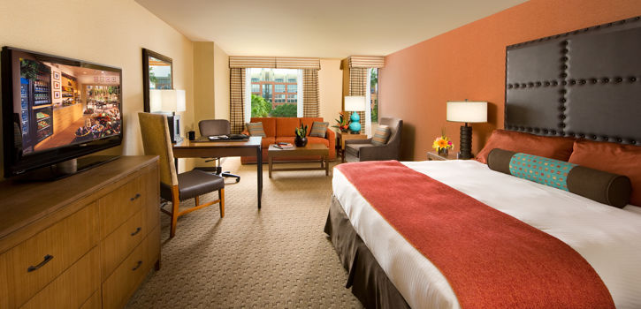
Executive Room

Slide 10
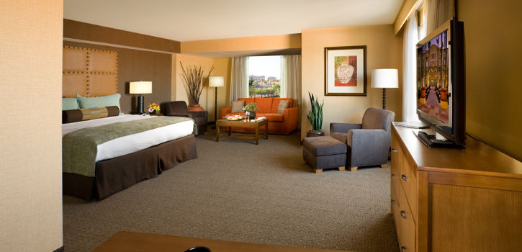
Junior Suite

Slide 11
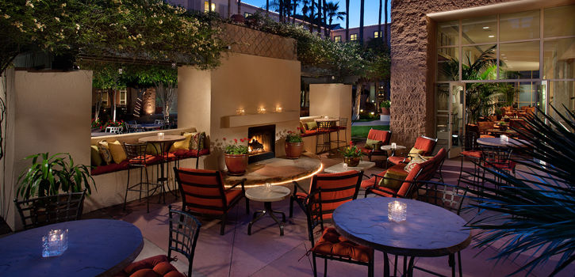
Harry’s Place
Open Monday through Friday, 2pm – midnight
Saturday and Sunday, 11am – midnight

Slide 12
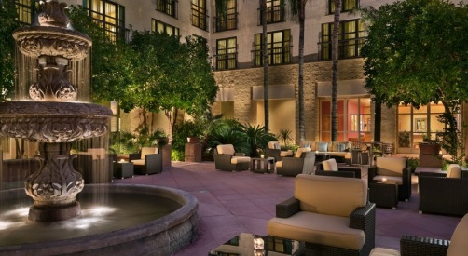
Courtyard Seating

Slide 13
Want a breathtaking view?
Come to the rooftop – access from

Slide 14
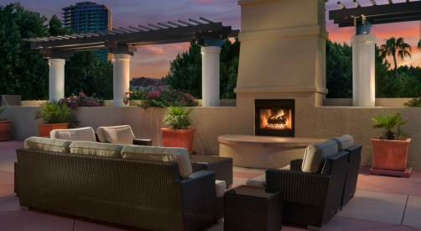
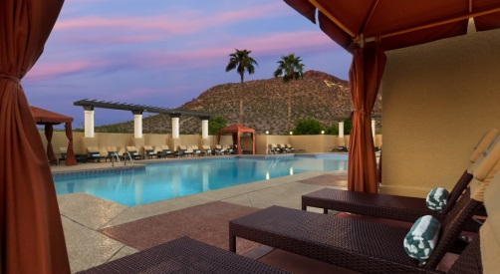
Fireplace
Pool and Cabanas

Slide 15
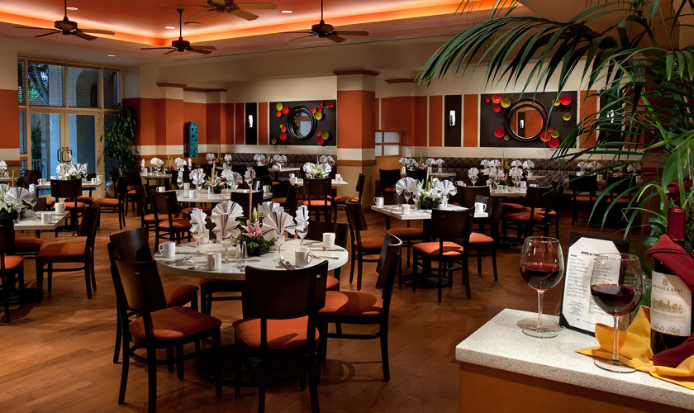
The Mission Grille

Slide 16
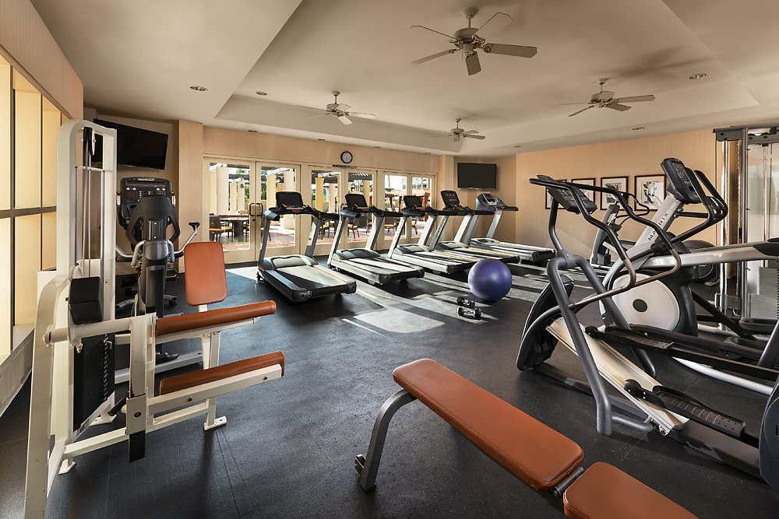
Fitness Center

Slide 18
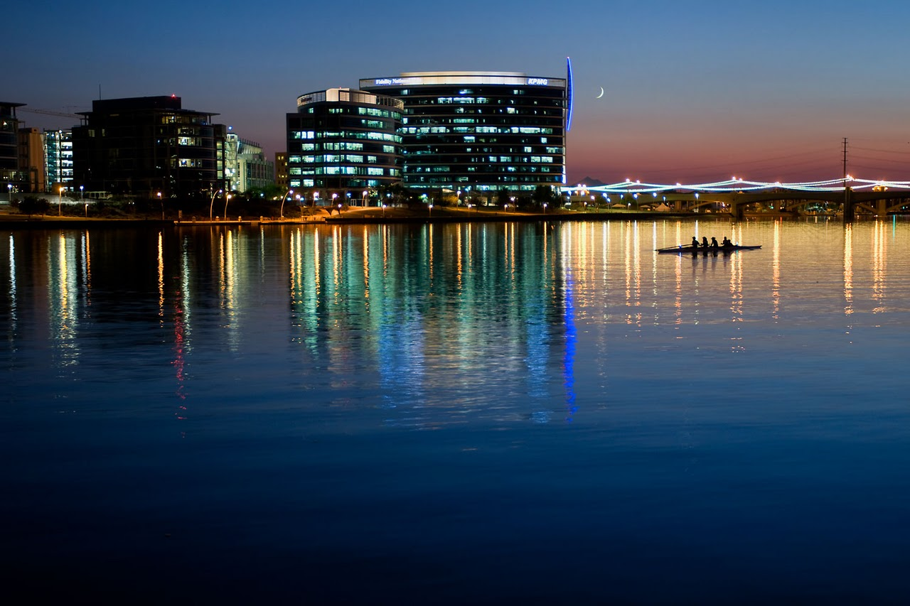

Slide 19
And of course the reason we are here… Meeting Rooms

Slide 20
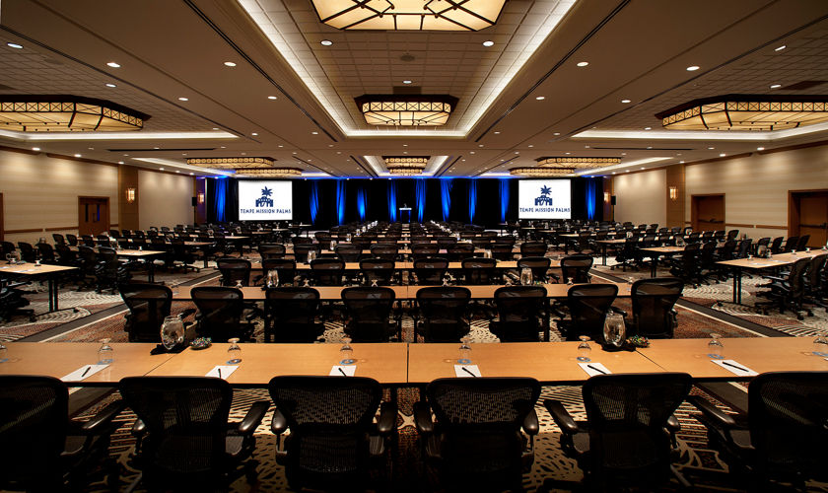

Slide 21
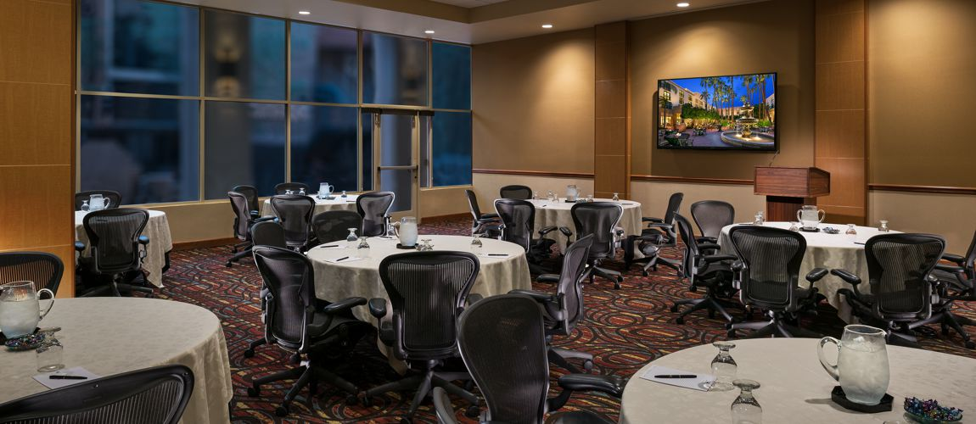

Slide 22
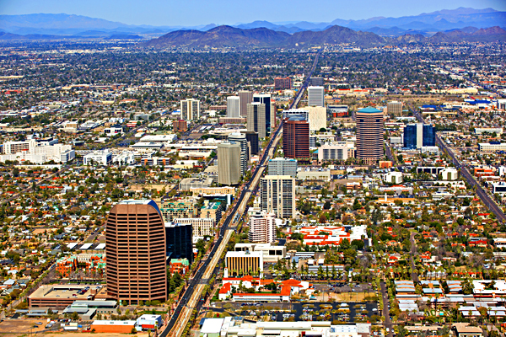
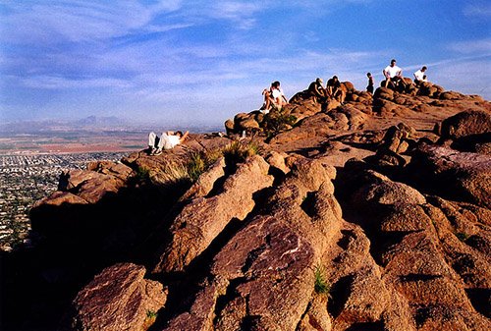
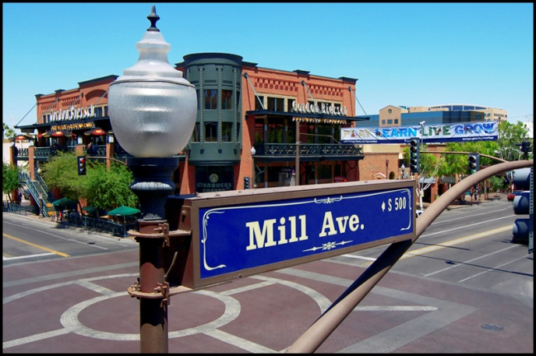
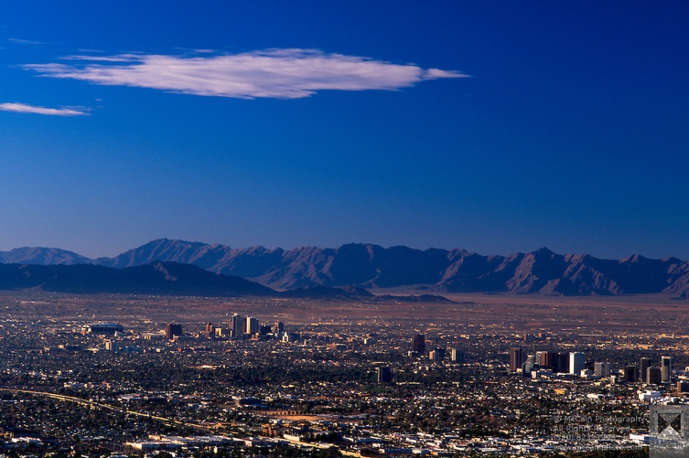
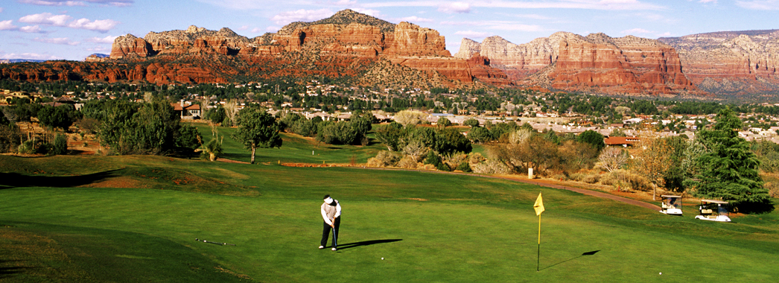
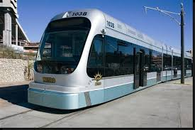

Slide 23
Join us in the Valley of the Sun! August 12-13, 2020 Tempe, AZ www.tempemissionpalms.com

